Slide 1
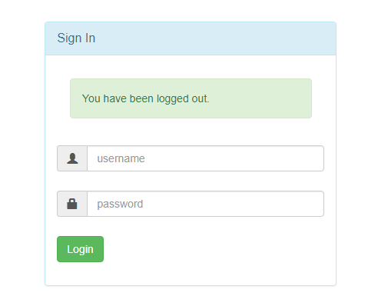
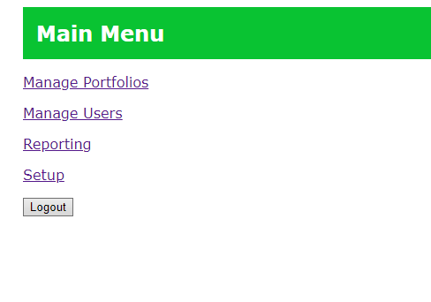
Sign-in and go to “Manage Portfolios”

Slide 2
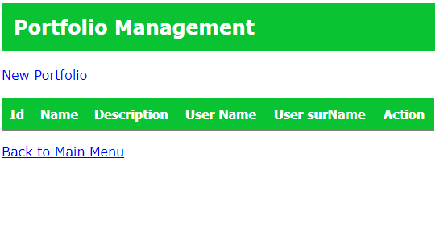
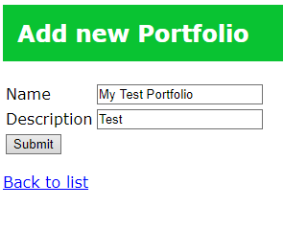
Create new portfolio

Slide 3

Choose “manage” to add stocks to portfolio

Slide 4
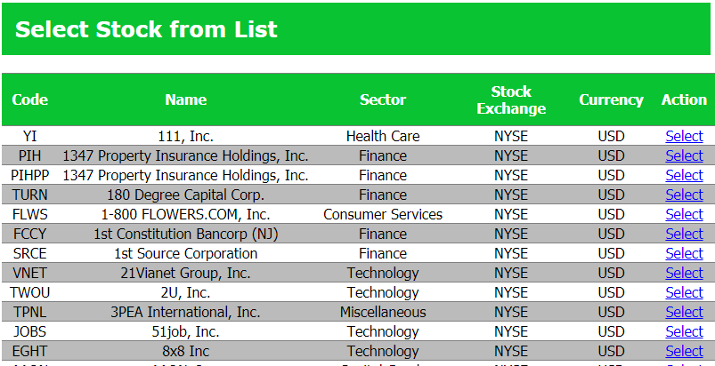
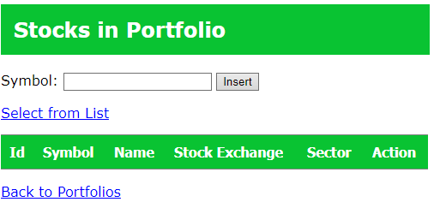
Select stock from list

Slide 5
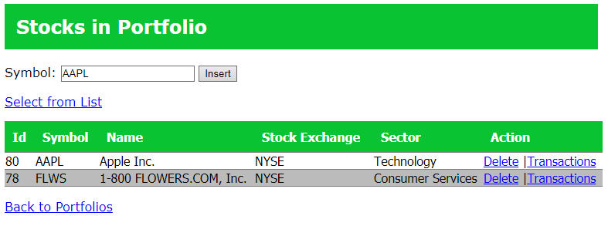
Or enter the ticker… Go to “transactions”

Slide 6
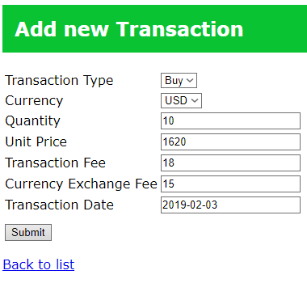
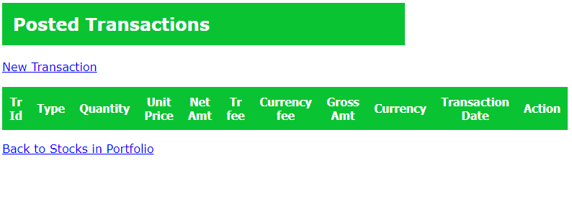
Add new Transaction, fill in all required fields

Slide 7
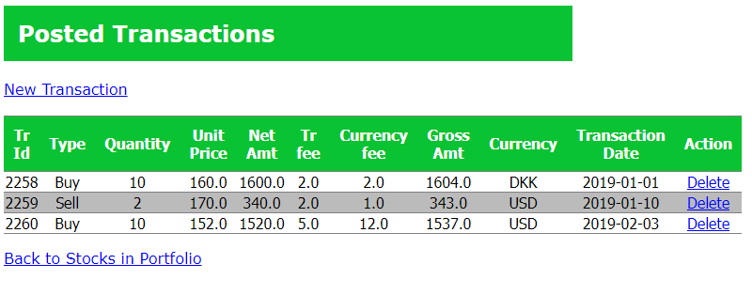
Add more transactions, go to main menu

Slide 8
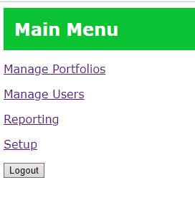
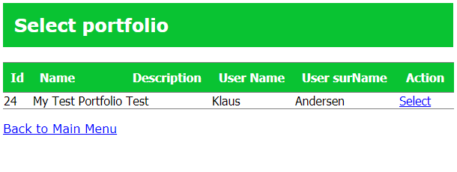

Slide 9

View performance for chosen portfolio
* Calculations here are likely not correct, they are just illustrative for now

Slide 10
